Slide 1
eMail Enterprise Records and Document Management System (eERDMS)
Program Overview
December 3, 2013
Presented to the FIRM Council

Slide 2
Agenda
Program Introduction
Our Approach
Schedules and Auto Classification
Integration and Migration
eForms
Challenges, Lessons Learned and the Future

Slide 3
The U.S. Department of the Interior protects America’s natural resources and heritage, honors our cultures and tribal communities, and supplies the energy to power our future.
Our agency mission
Cabinet-level agency with 14 Bureaus and Offices that manages:
  ~80,000 employees plus 280,000 volunteers
  $16.8B operating budget
  500 million acres of surface land
  479 dams and 348 reservoirs
  30% of the nation's energy production
  55,000 different maps each year
  ~500 million recreational and cultural visitors
  1 in 5 acres of land managed
Notes:
The Department of Interior protect America’s natural resources and heritage, honor our cultures and tribal communities, and supply the energy to power our future. As a result we are large in terms of employees and operating budget.

Slide 4
We have a structured IT Transformation program
Alignment under a single CIO
Defined outcomes
  Shift focus to Cloud First
  Bureaus buy services instead of infrastructure
  Meet or exceed expectations for reliability, accessibility and availability
$500 million savings over 10 years
High priority service areas for immediate modernization
eERDMS is one of the CIO’s high priority areas
Notes:
Secretarial Order 3309, issued in December 2010, provided an unprecedented opportunity to change the conversation about information technology at the Department of the Interior. It redirected oversight, management, ownership, and control of all Departmental information technology (IT) infrastructure in the Office of the Chief Information Officer.
Our records and document management program is supported by the Department executive leadership including the CIO.

Slide 5
Centralizing information governance is logical
Centralize all records management functions
Shift information management to cloud first
Provide centralized information governance for
  Departmental Records Offices;
  The Office of the Solicitor;
  The Office of the Executive Secretariat;
  The Office of the Inspector General;
  The Office of Cybercrimes;
  The Office of Freedom of Information Act;
  The Office of Ethics; and
  Congressional and Administrative Record

Slide 6
Agenda
Program Introduction
Our Approach
Schedules and Auto Classification
Integration and Migration
eForms
Challenges, Lessons Learned and the Future

Slide 7

Our well-defined vision guides the program
Provide the Department of the Interior with a single cohesive integrated information management program designed to manage records and documents for its missions and programs to ensure public trust and transparency
Notes:
Our records management program, which includes auto-classification, covers the whole department and all employees. Our vision is to:
Provide the Department with a single cohesive integrated information management program designed to manage records and documents for its missions and programs to ensure public trust and transparency

Slide 8
Our approach to realize our vision
Identify existing records schedules
Align schedules and LOBs to mission
Crosswalk records schedules to LOBs
Simplify records schedules
Prepare a DRS that aligns with LOBs
Incorporate auto-class for electronic records
Fully integrate with all record media
Incorporate RM practices into IL and/or SDL
Notes:
DOI has taken the following eight steps.
Identify existing records schedules. Ensure that they are up-to-date and applicable.
Align those schedules and LOBs to the agency mission and identify stakeholders for those mission areas. Your mission areas are usually identified in your Agency Strategic Plan.
Crosswalk records schedules to lines of business within the agency. Useful guidance includes the NAICS, which covers most lines of business for the Federal Government.
Simplify the records schedules based on commonality factors (retention, business relationship to other records). Simplification includes reducing and consolidation of variance of retention periods, as well as, the simplification of the schedules themselves. If there are variances, document them (e.g., statute, business need).
Prepare a Departmental Records Schedule that aligns records with LOBs and mission. Keep it high level so the component offices retain their identity but identify key common points across bureaus that will map to the Department.
Incorporate auto-categorization for electronic records using the new records management structure. Initially, DOI is starting with e-mail.
Fully integrate with all record media. A records management system needs to include all records “regardless of media”.
Incorporate records management practices into the agency Information Lifecycle/or and Systems Development Lifecycle, including standardized and specific contract language, change management processes and actions from your legal oversight groups (Solicitor, FOIA, IG, Ethics).

Slide 9











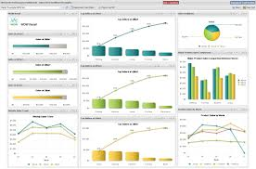


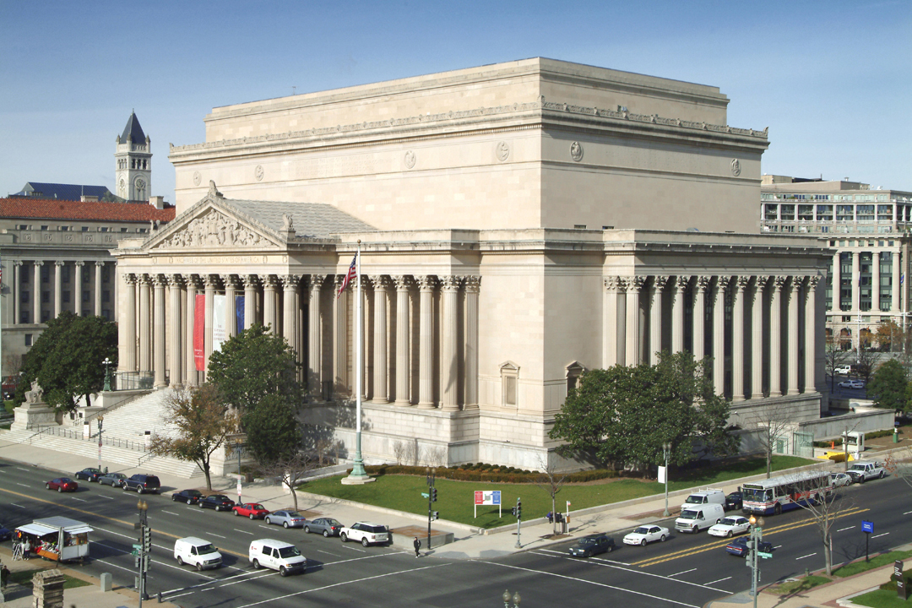


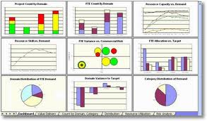



We created a cloud environment
CAPTURE
STORE / MANAGE / PRESERVE
DELIVER
Human Created
Information
End Users
Enterprise
Content System (ECS)
Enterprise
eArchive System (EES)
AUTO & MANUAL
CLASSIFICATION
Enterprise Dashboard System (EDS)
INDEXING
INPUT
EMAIL
JOURNALING
DOCUMENT
MANAGEMENT
NARA
RECORDS
MANAGEMENT
COLLABORATION &
WORKFLOW
MANDATED OUTPUT
Litigation
System Information
CASE MANAGEMENT
XML
Legacy Document
Systems
API or
MIGRATION
EARLY CASE
ASSESSMENT/eDISCOVERY
ERP
Systems
Financial
FISMA Moderate Cloud
Notes:
We created a FISMA moderate cloud environment using COTS products from OpenText. Our system design is DOD 5015.2, v.3, compliant and handles the complete life-cycle for our records management program – it is not just auto-classification.
Our security has nine levels of protection: (1) see, (2) see contents, (3) modify, (4) edit attributes, (5) add items, (6) delete versions, and (7) delete, and (8) reserve and (9) edit permissions. So privacy information such as medical records and personnel information are protected through permissions.

Slide 10
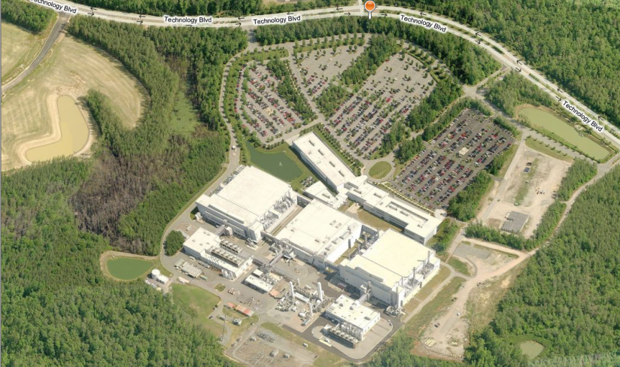
IQBG cloud facility
500,000 Sq Ft of Planned Raised Floor
Multiple Distinct Data Center Buildings
(Current Basis of Design)
Office Space
2
1
3

Slide 11
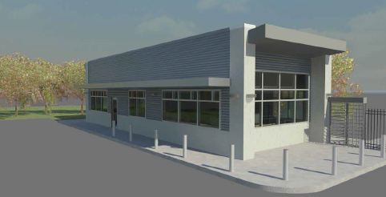
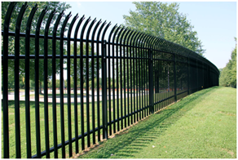
Multi-layered security
Committed to provide the highest level of security from the property perimeter to the data center floor
Secure Campus
500 foot setback to all buildings
K-8 rated fencing (K-12 capable)
Hardened, visitor screening facility with ballistic resistant fiberglass panels (Ballistic Level 3)
Defense anti-terrorism force protection with focus on TIA 942 and FISMA guideline fulfillment
FISMA Low through TS/SCI SCIF
Armed security officers
Metal detection devices
X-ray scanning instruments
Delta vehicle barriers
Internal Security
Central command center staffed 24x7x365 with roving guard force
Security monitoring with video surveillance and security cameras
Pedestrian turnstiles and badge reader systems separate common areas from datacenter space
Biometric access through Man-Traps for datacenter areas (card/fingerprint & retina)
Badge-in/badge-out security process, Vehicle Inspections
100+ CCTV cameras
Secure shipping and receiving docks

Slide 12
Our lifecycle management in eERDMS
CAPTURE | STORE | MANAGE | PRESERVE | DELIVER
 | Content Lifecycle Management | Records & Document Management | Archiving Solutions | Enterprise Search
Multi-Functional Device Scanning | Library Services | Workspaces | Integration Center for Data Archiving | Correspondence Tracking
Document Imaging | Repository | Legal Document Management | Archiving for SAP® and SharePoint® | National Shredding Program
Managed File Transfer |  | Business Process Management
Capture Center |  | Collaboration/ Workflow including Mobile Devices
Social Network Content Capture
Social Media Mobile Device Capture |  | Enterprise Dashboards
National Digitization Program |  | Auditing
Migration Services | Early/Advanced Early Case Assessment & Review
eFax/eForms | Email Management
Auto-Classification
Blue text denotes optional products and services
Notes:
Here is a list of capabilities for the eERDMS program. For the most part each item listed is an OpenText product. Some of the exceptions would be services provided by other vendors but under the same prime contract – National Digitization Program, National Shredding Program, and Migration Services. Migration Services is in part migrating existing records and document management systems to the new eERDMS platform for additional cost savings.

Slide 13



eERDMS status
Digitizing millions of Indian trust records; Preparing for 100 million paper objects annually | 800 million+ emails and attachments each year 1.6B+ indexed emails | 30+ terabytes electronic content sent each year Preparing for an Exabyte of electronic content
Providing support for FOIA, Congressional, Administrative Records, Ethics, Solicitor, and Inspector General requests
Addressing all of M-12-18 and M-13-13
Notes:
Exabyte (1024 petabytes or 1,048,576 terabytes)

Slide 14
Agenda
Program Introduction
Our Approach
Schedules and Auto Classification
Integration and Migration
eForms
Challenges, Lessons Learned and the Future

Slide 15
We use three classification strategies
Intelligent Classificaiton
Intelligent Classification
Volume
Auto-Classification
Structured Workflow Driven Automation
Manual
Risk of Misclassification
Low
High
Low
High
Notes:
The process of classifying records using eERDMS falls into three categories: Auto-classification, business process driven automation, and manual.
For each migration and or new system under consideration for deployment within eERDMS it will be up to the Bureau with consultation from the eERDMS program team to decide which one of the three options is the “best” option.
Auto-classification
Our focus has been applying auto-classification to email.
Used for high volume unstructured content
Potentially, used for large migrations of content from legacy systems
Once the model is created, there is little to no human effort to classify content – but managing the model is continuous process
Requires exemplar documents for each target classification (Line of Business (LOB) and retention).
Structured Workflow Driven Automation
Used for well-defined and structured processes; good for collecting additional metadata about the item.
Uses classification inheritance (i.e. documents placed in a container inherit the classification associated with that container).
Can be inner connected component with other system such as FBMS, forms, HR etc.
There are multiple levels of automation (or human intervention) depending on the business process and content
For example, a workflow might automatically place the record in the correct location and collect necessary metadata.
Another example would be where content is automatically ingested into eERDMS from a source system and the necessary classification and storage location is programmatically defined.
Little to some human effort to classify content, such as quality control and reviewing the outcome of the business process
Manual
Used for content that cannot be classified using auto-classification or structured workflow driven automation
Human effort required to classify each piece of content
Least desirable classification option. A strong effort should be used to classify content using auto-classification or structured workflow driven automation before considering manual classification.

Slide 16
Auto-classification starts with a consolidated schedule
200 schedules / 2330 retention periods
Individual Bureau Schedules
1 schedule with
37 lines of business having
189 retention periods
Departmental Records Schedule
Notes:
So now let’s focus on auto-classification. Electronic records management requires simplified records retention schedules. We consolidated the Department’s 14 bureaus schedules (numbering 200 with 2330 retention periods) into one Department schedule with 37 lines of business and 189 retention periods, which we call our Department Records Schedule or DRS. GRS records series are included in our DRS.

Slide 17
Our consolidated schedule is organized in 4 big buckets
Mission - 26 lines of business organized by DOI strategic goals
  Provide natural and cultural resource protection
  Manage energy, water, and natural resources
  Relationships with Indian Nations
  Scientific foundation for decision making
  Building a 21st Century DOI
Administrative
  Administration
  Finance & Acquisition
  Information Technology
Policy
  Controls & Oversight
  Judicial & Legislative Activities
  Regulatory Development
Legal, Regulatory Compliance, and Enforcement
  Intelligence Operations
  Investigations & Audits
  Law Enforcement
  Litigation & Adjudications

Slide 18
How does our auto-classification work?
Semantic
Contents
Model of Exemplars
New Record
A
B
C
Similar Exemplars List
Line of Business & Retention Period
Decision
Algorithm
Notes:
Auto classification - A software feature that will scan the contents of a document (including metadata) and automatically assign classification(s) from a file structure based on the document contents.
A new document (email, attachment, correspondence, report, etc.) is captured in Content Server and indexed. It is then run through the auto-classification system.
The AC System semantically analyzes the contents of the document against all of the exemplars in the model. The exemplar documents in the model have all be classified manually and should be good examples of the records needed to conduct the tasks for that line of business.
The AC system compares the new document to all the other items in the model and identifies those having the greatest degree of similarity. The AC system is looking at more than key words. It examines the tone and semantic relationships between words and phrases and document structures.
The document is compared to the documents which are most similar to it in the model. A decision algorithm is used to determine the line of business and retention period to be assigned to it.
The assignment is made automatically in OTAC and is applied to the document in Content Server.

Slide 19
We collect exemplars to build an OTAC model
AUTO-CLASSIFICATION FOCUS IS ON EMAIL NOW
Ongoing fine tuning of OTAC model
Collect exemplars from bureaus
(200 per LOB retention node)
OTAC Training
(Auto-Classification) – includes scheduling and planning
Building and tuning OTAC model
We are implementing multiple models
OpenText Auto Classification = OTAC
Notes:
The OpenText auto-classification (OTAC) software utilizes exemplars (which are samples of documents representative of a task in a line of business) to train the system to recognize similar documents. Lines of business are comprised of multiple tasks: each task needs a variety of records to represent it in the OTAC system. We initially use 200 exemplars to represent each retention in each line of business to establish a baseline model. Which means that per our DRS, we actually have to collect about of 75K exemplars.
Once exemplars are collected, we train the Bureau Records Officers to use the OTAC system and build their models. Models run against the journaled email or record content for assignment of retention categories (line of business and retention period). Continuous quality control is built into the process.
For the content the system cannot classify, random samples are chosen for human categorization. Once a group of newly manually classified items is classified, the remaining unclassified are run against the new model for classification (and continuous system improvement). Model refinement is an on-going process of collecting more exemplars to replace old exemplars, reflecting the evolution of business processes over time.
We have been working with OpenText on software changes to allow the Bureaus to create and run their own models independently. We received the software upgrade this week and are in the process of loading onto our production instance.

Slide 20
Auto-classification and event-driven retention
In order to impose automation on event-driven retention processes
  Assign a year (i.e. 10 years from creation) so that the system notifies you that a retention period may have been met
  System retention notices serve as a tickler to the Records Manager to further investigate this record group’s disposition
  Coordinate with the records’ originating Program Office and Legal staff to determine the actual date of closure and the retention period
  Process may have to be repeated for especially long business process cycles (i.e. dam construction – checking status every 10 years)
Consolidate event-driven retentions supporting a single business function whenever possible
As business processes are automated, fewer individual event-driven retention periods should be necessary
Notes:
Event-driven retentions are especially thorny to automate unless tied to management information systems; queuing that a process is complete (i.e. contract closure reporting; case closure)

Slide 21
Documents are “tagged” with holds
Electronic
Documents
Each hold can be separate from other holds
Documents inherit longest hold
Auto-classification and automated searches can be applied
Front-end and back-end services remain available
Production
Research, Collection, eDiscovery
Legal Holds
FOIA Holds
Congressional Holds
Administrative Holds
Investigative Holds
Bureau Storage
Notes:
Content is derived from email, electronic documents, physical content

Slide 22
Demonstration
OpenText Auto-Classification (OTAC)

Slide 23
Agenda
Program Introduction
Our Approach
Schedules and Auto Classification
Integration and Migration
eForms
Challenges, Lessons Learned and the Future

Slide 24
New/System migration planning has just begun
2 Doc/Records Systems
2 Indexing Systems
4 Legacy eMail Systems
2 Business Systems
1 Legacy eMail System
Migration
1 Business System
2 Doc / Records Systems
Integration
3 Business Systems
3 Business Systems
1 Business System
1 Digitization Project
1 Business Workflow System
1 Business System
New Project
Discovery
Analysis & Estimation
Go / No-Go
Design & Implement
Production Rollout
(includes user training & developing SOP
Status as of Nov 15, 2013
Notes:
Remember that we have 14 bureaus – each with their own legacy systems for document and records management. This planning matrix is just the tip of the iceberg in terms of potential content for migration.

Slide 25
Agenda
Program Introduction
Our Approach
Schedules and Auto Classification
Integration and Migration
eForms
Challenges, Lessons Learned and the Future

Slide 26
Yesterday’s forms environment
Decentralized forms management
  Lack of enterprise controls on how many forms are created and released
  Different organizations create forms for same business process
Lack of tracking of data
Manual validation of form data
Lack of support for mobile workforce
Forms processing delays; including lost forms
…Leading to a high cost of forms management

Slide 27
What does eForms do for forms management?
  Establishes a single web accessible portal for all forms
  Consolidates and automates bureau forms
  Identifies common repeatable workflow processes
    Notifications via email
  Provides automated processes for Department and public users
  Ability for online, offline and mobile forms processing
  Automated records disposition
  Ability to view business trend analysis and processing metrics
Notes:
We have over 20,000 forms across the Department – and we are still identifying more.
Many departmental form approval processes have similar workflows or steps to route a submitted form. By identifying the similar steps we are able to distill the business

Slide 28
eForms format capabilities
Capabilities
HTML5 Web Form
Electronic PDF
Printable PDF
(Print and fill out)
Mobile Supported
✓
X
X
Field Level Data Validation
✓
✓
X
Logic Based Business Rules
✓
✓
X
Collapsible Sections
✓
✓
X
Built In Navigation
(Wizard Style)
✓
✓
X
Save and Return
✓
✓
X
Electronic Signatures
✓
✓
X
In-line Help Text
✓
✓
X
Electronically Attached Files
✓
✓
X
Track Form Usage Metrics
✓
✓
X
Electronic Submission
✓
✓
X
Manual Submission
(Fax or Mail)
~
~
✓
Wet Signature
~
~
✓
✓
Fully Capable
~
Partially Capable
X
Not Capable

Slide 29
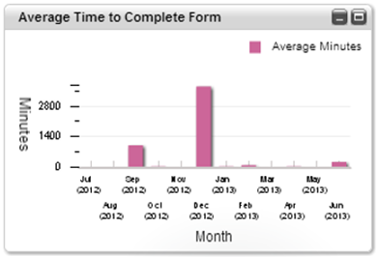
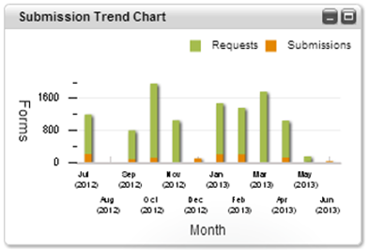
eForms default reporting capabilities
Report Title | Data Reported
Bureau Operational Summary | Provides an overview of transactions for a specific bureau
Operational Summary | Provides an overview of transactions for all bureaus
Bureau Transaction Report | Provides transaction statistics for a bureau, broken down by day and month
Transaction Report | Provides transaction statistics, broken down by day and month
Notes:
Reports may be exported in the format presented, .PDF, or as .CSV and .XLS.

Slide 30
Agenda
Program Introduction
Our Approach
Schedules and Auto Classification
Integration and Migration
eForms
Challenges, Lessons Learned and the Future

Slide 31
No system is without its challenges
Gaining leadership support and funding
  DOI has a decentralized management structure
  Use WIIFM (“What’s in it for me?”)
Adapting to a new Department-wide email (Gmail) 6 months into implementation
Managing DOI requirements within a COTS environment
Capturing 2-3 million emails a day plus attachments
Continuously identifying transitory and ultra-transitory
Implementing a centralized system in a decentralized organization
Supporting seasonal growth and national events
Notes:
Google email not easily compatible with other systems

Slide 32
Lessons learned so far
Communicate constantly in terms “they” understand
  To management, users, system admin, vendor partners, etc.
  Need to present the big picture to all stake-holders and present changes in stages
Designate a full-time change management / communication champion
Manage user expectations and scope creep
Establish a strong implementation team
Plan for the long term with iterative steps

Slide 33
We are in constant motion…
Capture and manage litigation holds
Develop automated processes for records capture, litigation holds, preservation, and attorney support
Centralize all Bureaus’ records programs
Migrate legacy content management systems
Convert and automate over 20,000 forms
Integrate 1,700 mission dashboards
Provide continuous training and communication and outreach
Support mobile platforms
Notes:
Our strategy includes completing these items by FY20

Slide 34
Questions?
Edwin McCeney
Departmental Records Officer
Department of the Interior
Office of the Chief Information Officer
Policy, Planning and Management
Edwin_McCeney@ios.doi.gov
(202) 208-3321
Prime Contractor
IQ Business Group
Carol Brock, Vice President, Information Governance
cbrock@iqbginc.com
(512) 415-5434
Contract No. D12PC00403
www.iqbginc.com
John Montel
Deputy, eRecords Officer
Department of the Interior
Office of the Chief Information Officer
Policy, Planning and Management
John_Montel@ios.doi.gov
(202) 208-3939
Notes:
I want to take this opportunity to thank …… for arranging for this presentation and the opportunity to share our experiences with all of you. We will send this presentation to all participants who registered for today’s meeting. Please contact us with any comments or questions.

